Slide 1
Clustering
Clustering is the process of grouping a set of data objects into multiple groups/ clusters. Objects within cluster have high similarity whereas objects of other clusters are dissimilar.
Inherent Structure
Unusual behaviour
Clustering
Partitioning
Hierarchical
Divisive
Agglomerative
K-means

Slide 2
Partitioning methods: Given a databases of n objects or data tuples, a partitioning methods constructs k partitions of data, where each partition represents a cluster and k ≤ n. Given k, the number of partitions to construct, it creates an initial partitioning. It then uses an iterative relocation technique that attempts to improve the partitioning by moving objects from one group to another. The general criterion of a good partitioning is that objects in the same cluster are “close” or related to each other, whereas objects of different clusters are “far apart”. For example, the k-means method is one of the partitioning methods commonly used.

Slide 3
Hierarchical methods: A hierarchical method creates a hierarchical decomposition of the given set of data objects. It can be either agglomerative or divisive. The agglomerative (bottom-up) approach starts with each object forming a separate group. It successively merges the objects close to one another, until all of the groups are merged into one, or until a termination condition holds. The divisive (topdown) approach starts with all objects in the same cluster. In each successive iteration, a cluster is split up into smaller clusters, until eventually each object is in one cluster or until a termination condition holds. BIRCH is an example of integration of hierarchical method with distance-based clustering

Slide 4
Density-based methods: This method is based on density such as density-connected points. The main idea is to continue growing a given cluster as long as the density in its “neighborhood” exceeds some threshold. That is, for each data point within a given cluster, the neighborhood of a given radius has to contain at least a minimum number of points. This method can be used to filter out noise and discover clusters of arbitrary shape. DBSCAN is a typical example of density-based clustering method.
Grid-based methods: Such methods quantize the object space into a finite number of cells that form a grid structure. All of the clustering operations are performed on the grid structure. The main advantage of this approach is its fast processing time, which is typically independent of the number of data objects and dependent only on the number of cells in each dimension in the quantized space. STING is an example of a grid-based method.

Slide 5
Model-based methods: This approach hypothesizes a model for each of the clusters and finds the best fit of the data to the given model. It locates the clusters by constructing a density function that reflects the spatial distribution of the data points. It also leads to a way of automatically determining the number of clusters based on standard statistics, taking “noise” or outliers into account and thus yielding robust clustering methods. COBWEB is an example of a statistical approach of a model-based method.

Slide 6
K means

Slide 7
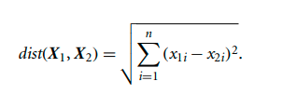
Distance measure for K means
For k-means the distance function to find the distance between two data objects is an Euclidean distance function:

Slide 8
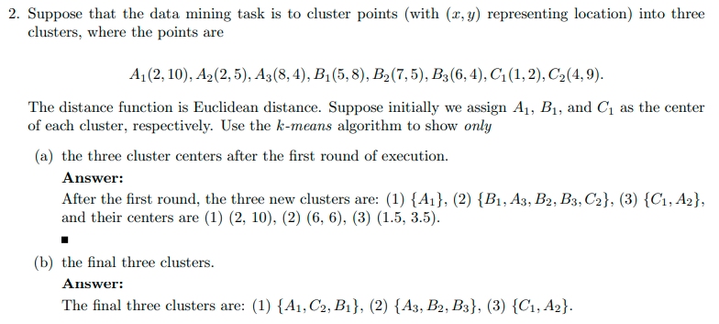
Example of K means

Slide 10
TRANSACTIONS | ONION | POTATO | BURGER | MILK | COKE_BUY
T1 | 1 | 1 | 1 | 0 | 0
T2 | 0 | 1 | 1 | 1 | 0
T3 | 0 | 0 | 0 | 1 | 1
T4 | 1 | 1 | 0 | 1 | 0
T5 | 1 | 1 | 1 | 0 | 1
T6 | 1 | 1 | 1 | 1 | 1
K-modes clustering
T1 | 1 | 1 | 1 | 0 | 0
T2 | 0 | 1 | 1 | 1 | 0
T4 | 1 | 1 | 0 | 1 | 0
 | 1 | 1 | 1 | 1 | 0
 | MODE (M1)
Step 1: Assume K=2 and cluster centers are tupple 1 and 6.
Step 2: Calculate the distance between initial modes and tupple.
C 1
C 2
Intermediate clusters
T3 | 0 | 0 | 0 | 1 | 1
T5 | 1 | 1 | 1 | 0 | 1
T6 | 1 | 1 | 1 | 1 | 1
 | 1 | 1 | 1 | 1 | 1
 | MODE (M2)
Dissimilarity Matrix
Partition Matrix
Step 3: Obtain updated cluster modes. (M1 and M2)

Slide 11
Step 4: Again calculate the distance between modes and all the objects until constant cluster or cost is achieved.
T1 | 1 | 1 | 1 | 0 | 0
T2 | 0 | 1 | 1 | 1 | 0
T4 | 1 | 1 | 0 | 1 | 0
 | 1 | 1 | 1 | 1 | 0
 | MODE (M1)
C 1
C 2
Final clusters
Binary Partition
Matrix
T3 | 0 | 0 | 0 | 1 | 1
T5 | 1 | 1 | 1 | 0 | 1
T6 | 1 | 1 | 1 | 1 | 1
 | 1 | 1 | 1 | 1 | 1
 | MODE (M2)
Dissimilarity Matrix
Since the clusters are constant therefore we stop the process.
Conclusion: Clustering based on number of item bought.
Issues

Slide 12
Issues in clustering
Sensitive to the cluster centers.
Generating local optimal solution.
Identify the distance measure
Number of clusters
GA

